Slide 1
Second Year B. Tech. Advanced Data Structures (CS228)
By
Dr. Pramod D. Ganjewar
Senior Assistant Professor,
School of Computer Engineering,
MIT Academy of Engineering, Alandi(D.),Pune

Slide 2
Unit – 1 Trees Threaded Binary Tree Concepts, Construction, Traversals, Insert and Delete Operations

Slide 3
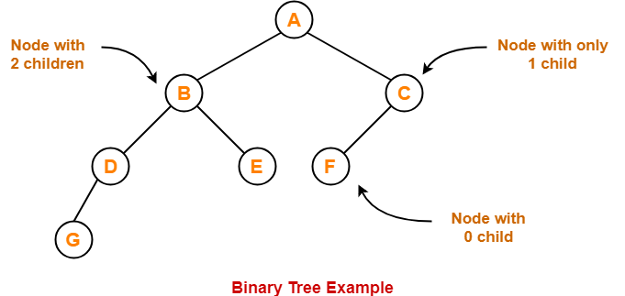
Binary Tree
Binary Tree
Binary tree is a special tree data structure in which each node can have at most 2 children.
Thus, in a binary tree, Each node has either 0 child or 1 child or 2 children.

Slide 4
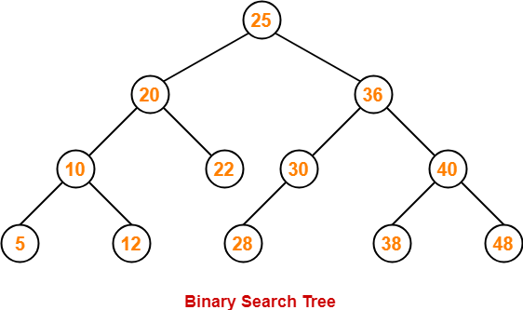
Binary Search Tree
Binary Search Tree
Binary Search Tree is a special kind of binary tree in which nodes are arranged in a specific order.
In a binary search tree (BST), each node contains-
Only smaller values in its left sub tree
Only larger values in its right sub tree

Slide 5
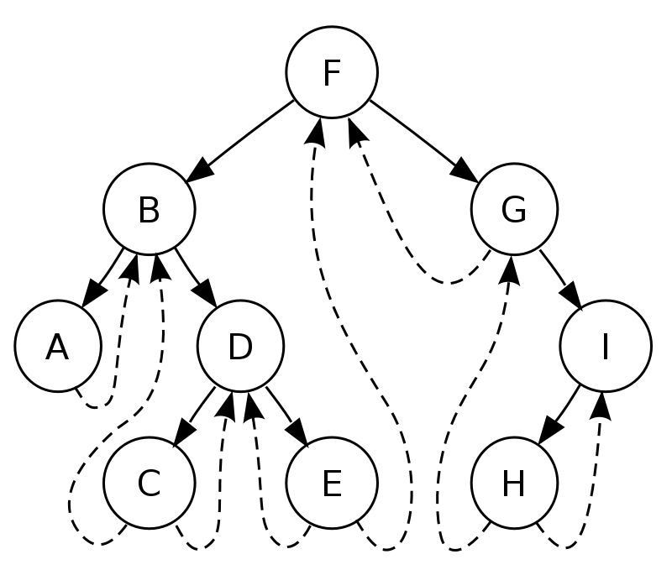
Threaded Binary Tree
Threaded Binary Trees by name suggests that the nodes are connected with threads / links.
This uses linked representation of the binary tree to make it threaded binary tree.
A threaded binary tree is defined as follows:
"A binary tree is threaded by making all right child pointers that would normally be null point to the in-order successor of the node (if it exists), and all left child pointers that would normally be null point to the in-order predecessor of the node.“
^{In-order – A,B,C,D,E,F,G,H,I}
In-order Successor – Immediate next in In-Order Traversal,
In-order Predecessor – Immediate previous in the In-Order Traversal.

Slide 6
Advantages of TBT Over BST / BT
In simple iterative In-order traversal, we need to use the stack for In-order traversal of the tree; thus, by converting tree to threaded binary tree, we don’t need to use the stack for the In-order traversal. Thus it saves space.
The second advantage is that less traversal is required for the traversals from a child node to root node; thus, this would enhance the searching feature in the tree algorithms, which requires a constant flow of the logic to go upward and backward frequently in a tree.

Slide 7
Types of TBT
Single Threaded:
Each node is threaded towards either the in-order predecessor or successor (left or right).
Double threaded:
Each node is threaded towards both the in-order predecessor and successor (left and right).
In Double Threaded Binary Tree, the left pointer of the node should point to the In-order predecessor, and the right pointer should point to the In-order successor. The only exception is that the left pointer of the leftmost node in a tree, and the right pointer of the rightmost node in a tree should point to NULL.
In Single Threaded Binary Tree either the left pointer or right pointer of the node points to the In-order predecessor or successor. Exception is same of Double Threaded Binary Tree is that the left pointer of the leftmost node in a tree, and the right pointer of the rightmost node in a tree should point to NULL.

Slide 8
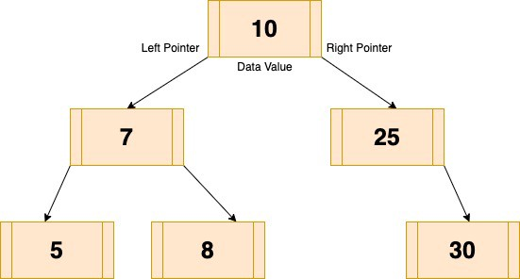
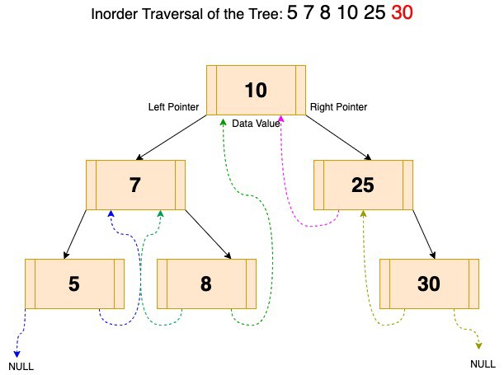
Example - Threaded Binary Tree
Rules for Converting BT / BST to Threaded BT / BST
Right child pointers that would normally be null point to the in-order successor of the node (if it exists).
All left child pointers that would normally be null point to the in-order predecessor of the node (if it exists)

Slide 9
Operations on TBT
Following Operations can be performed on TBT
Construction
Insertion
Deletion
Traversing (Recursive and Non-Recursive)

Slide 10
TBT - Construction
The Inorder traversal of the above tree is:
5 ->7 -> 8 -> 10- > 25 -> 30
(In case you forgot In-order traversal it is: Visit Left Node, Then Root Node, Then Right Node)

Slide 11
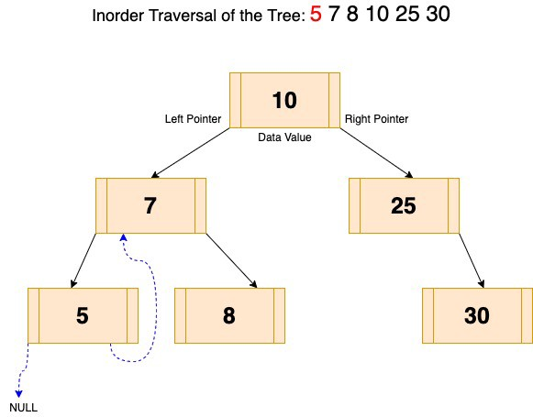
TBT Construction – Example (Steps - 1)
Let’s start the traversal, and we traverse till the Left most node of the tree:
Step – 1
Traversal for node value 5
In this Left most node is 5.
The Inorder predecessor of 5 is NULL; thus, it points to NULL.
Inorder successor of 5 is 7, therefore the right pointer of the node value 5 points to 7.

Slide 12
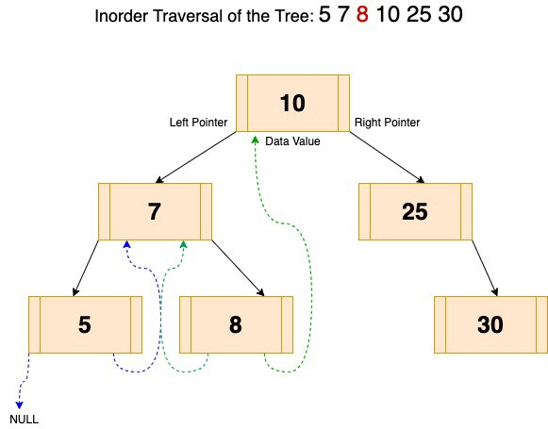
TBT Construction – Example (Steps - 2)
Step - 2
Traversal for node value 8
In the above image, recursively going back to the root node (7), it checks for the right node.
In this case, the right node of node value 7 is 8.
First, we will check the left pointer of the node; if it NULL, then we will point it to the successor of the node, which is 7.
For the right pointer, we will check if it is pointing to NULL, then we will modify the reference to the successor node, which is 10 thus, it will point to 10.

Slide 13

TBT Construction – Example (Steps - 3)
Step – 3 :- Similarly for 25

Slide 14
TBT Construction – Example (Steps - 4)
Step – 4 :- Similar logic for 30. As this is the rightmost node of the tree, its right pointer would point to NULL.

Slide 15
TBT – Insert Operation
Insertion in TBT have following cases
Case 1: Insertion in empty tree
Case 2: When new node inserted as the left child
Case 3: When new node is inserted as the right child
Case 1: Insertion in empty tree
Both left and right pointers of tmp will be set to NULL.
new node becomes the root.
Algorithm
tmp -> left = NULL;
tmp -> right = NULL;
root = tmp;

Slide 16
TBT – Insert New Node as Left Child
Predecessor of 14 becomes the predecessor of 13, so left thread of 13 points to 10.
Successor of 13 is 14, so right thread of 13 points to left child which is 13.
Left pointer of 14 is not a thread now, it points to left child which is 13.

Slide 17
TBT – Insert New Node as Left Child
Case 2: When new node inserted as the left child
After inserting the node at its proper place we have to make its left and right threads points to inorder predecessor and successor respectively. The node which was inorder successor.
So the left and right threads of the new node will be-
tmp -> left = par ->left;
tmp -> right = par;
Before insertion, the left pointer of parent was a thread, but after insertion it will be a link pointing to the new node.
par -> lthread = false;
par -> left = temp;
Following example show a node being inserted as left child of its parent.

Slide 18
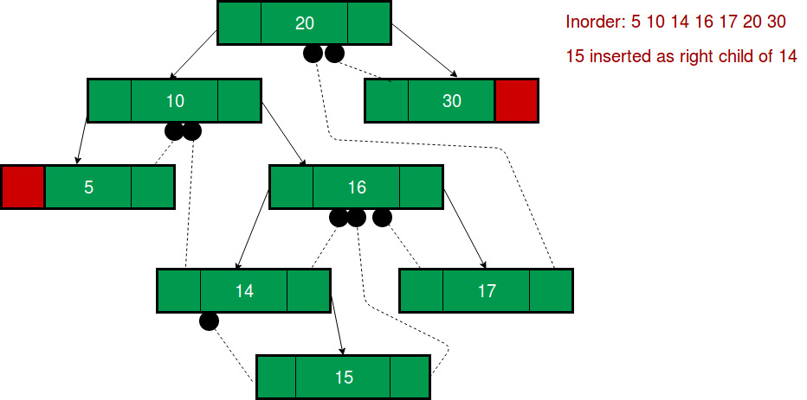
TBT – Insert New Node as Right Child
Successor of 14 becomes the successor of 15, so right thread of 15 points to 16
Predecessor of 15 is 14, so left thread of 15 points to 14.
Right pointer of 14 is not a thread now, it points to right child which is 15.

Slide 19
TBT – Insert New Node as Right Child
Case 3: When new node is inserted as the right child
The parent of tmp is its in-order predecessor.
The node which was in-order successor of the parent is now the in-order successor of this node tmp.
So the left and right threads of the new node will be-
tmp -> left = par;
tmp -> right = par -> right;
Before insertion, the right pointer of parent was a thread, but after insertion it will be a link pointing to the new node.
par -> rthread = false;
par -> right = tmp;
Following example shows a node being inserted as right child of its parent.

Slide 20
TBT – Deletion Operation
Cases need to be considered are as follows
Case A: Leaf Node need to be deleted (Right / Left Child )
Case B: Node to be deleted has only one child (Left / Right Subtree)
Case C: Node to be deleted has two children (Intermediate Node with Left and Right Subtree / leaf node)
Case A: Leaf Node need to be deleted (Right / Left Child )
In BST, for deleting a leaf Node the left or right pointer of parent was set to NULL.
Here instead of setting the pointer to NULL it is made a thread.
Algorithm
par -> lthread = true;
par -> left = ptr -> left;

Slide 21
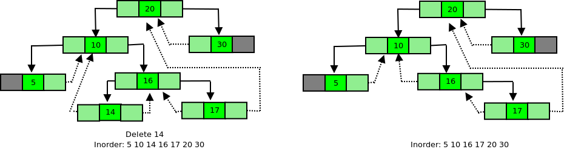
TBT – Deletion of Left Child
If the leaf Node is to be deleted is left child of its parent then after deletion, left pointer of parent should become a thread pointing to its predecessor of the parent Node after deletion.

Slide 22
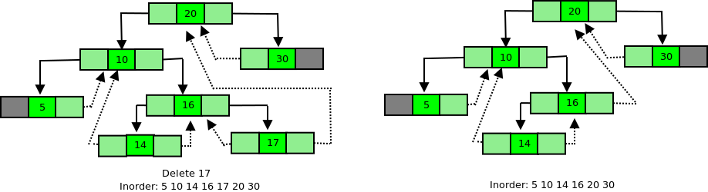
TBT – Deletion of Right Child
If the leaf Node to be deleted is right child of its parent then after deletion, right pointer of parent should become a thread pointing to its successor. The Node which was in-order successor of the leaf Node before deletion will become the inorder successor of the parent Node after deletion.

Slide 23
TBT – Deletion of Node Having Single Child
Case B: Node to be deleted has only one child (Left / Right Subtree)
After deleting the Node as in a BST, the inorder successor and inorder predecessor of the Node are found out.
s = inSucc(ptr);
p = inPred(ptr);

Slide 24
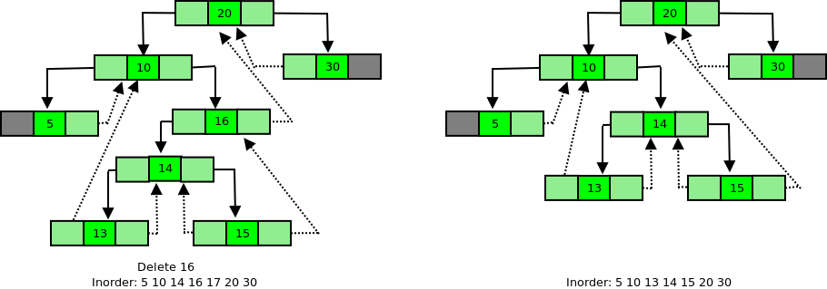
TBT – Deletion of Node Having Left Subtree Only
If Node to be deleted has left subtree, then after deletion right thread of its predecessor should point to its successor.
predecessor->right = s;
Before deletion 15 is predecessor and 20 is successor of 16. After deletion of 16, the Node 20 becomes the successor of 15, so right thread of 15 will point to 20.

Slide 25
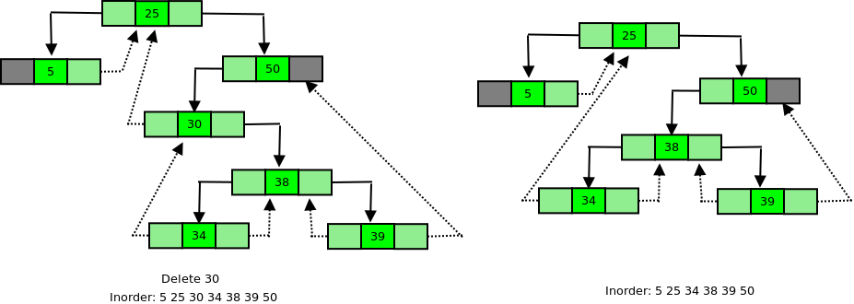
TBT – Deletion of Node Having Right Subtree only
If Node to be deleted has right subtree,
then after deletion
left thread of its successor should
point to its pre-decessor.
successor->left = predecessor;
Before deletion of 25 is predecessor and 34 is successor of 30. After deletion of 30, the Node 25 becomes the predecessor of 34, so left thread of 34 will point to 25.

Slide 26
TBT – Deletion
Case C: Node to be deleted has two children
We find inorder successor of Node ptr (Node to be deleted) and then copy the information of this successor into Node ptr.
After this inorder successor Node is deleted using either Case A or Case B.

Slide 27
TBT – Recursive Traversal
Inorder(node)
if (node.left is not a thread link)
preorder(node.left)
print node
if (node.right is not a thread link)
preorder(node.right)
Preorder(node)
print node
if (node.left is not a thread link)
preorder(node.left)
if (node.right is not a thread link)
preorder(node.right)
Postorder(node)
if (node.left is not a thread link)
postorder(node.left)
if (node.right is not a thread link)
postorder(node.right)
print node

Slide 28
TBT – Recursive Traversal
Pre-order Traversal (Root – Left – Right)
Pre-Order Traversal :- 10, 7, 58, 25, 30.
In-Order Traversal (Left-Root-Right)
In-Order Traversal :- 5, 7, 8, 10, 25,30
Post-Order Traversal (Left-Right-Root)
Post-Order Traversal :- 5, 8, 7, 30, 25, 10

Slide 29
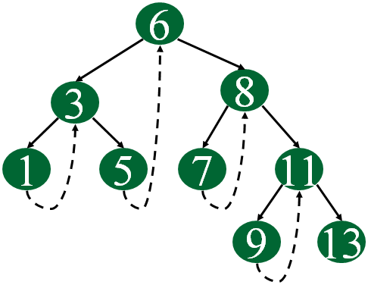
TBT – Non-Recursive Traversal – In-order
Algorithm for Non-Recursive Traversal of TBT :-
Start at leftmost node and print it.
Follow thread to right and print it.
Follow link to right go to leftmost node and print it.
Follow thread to right and print it.
(repeat)

Slide 30
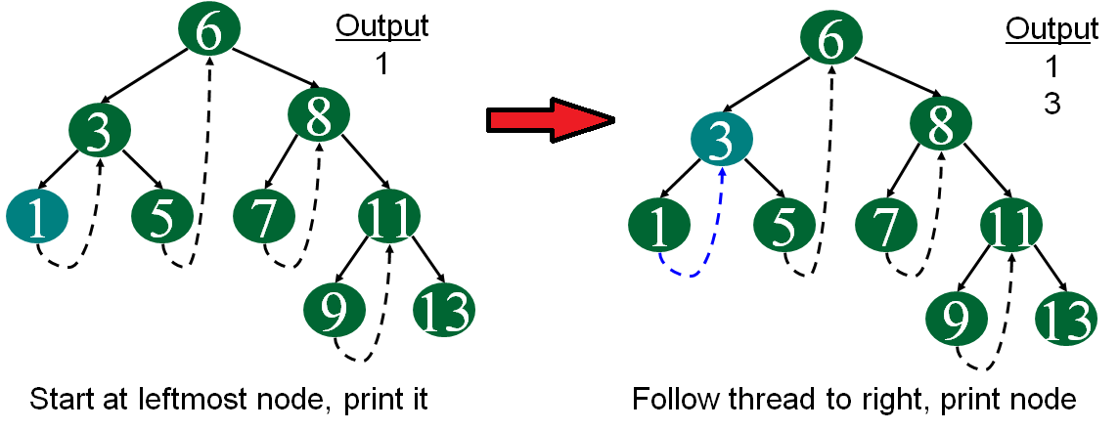
TBT – Non-Recursive Traversal - Inorder

Slide 31
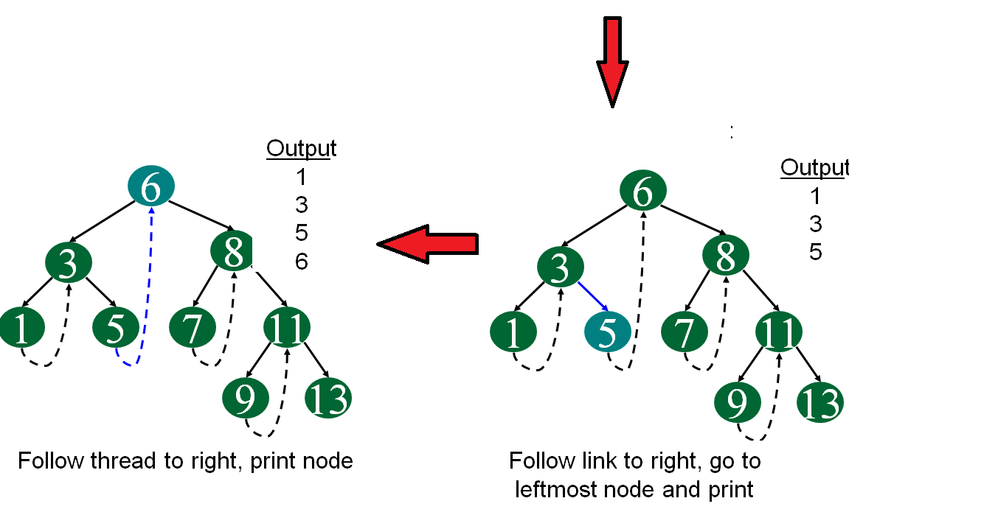
TBT – Non-Recursive Traversal – In-order

Slide 32
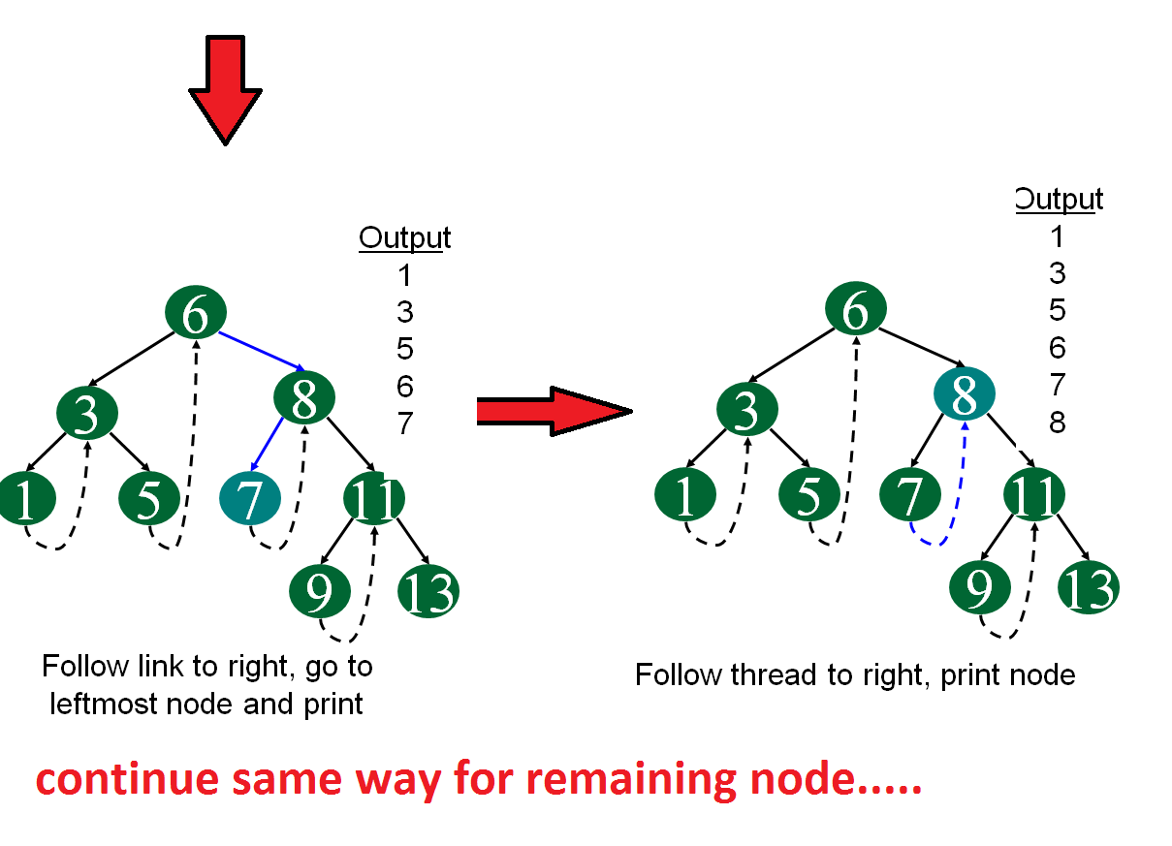
TBT – Non-Recursive Traversal – In-order

Slide 33
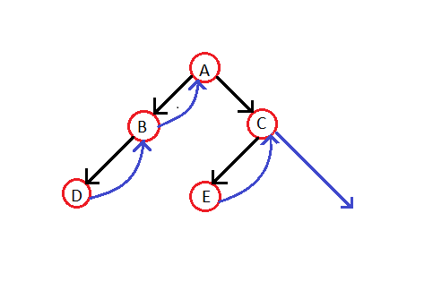
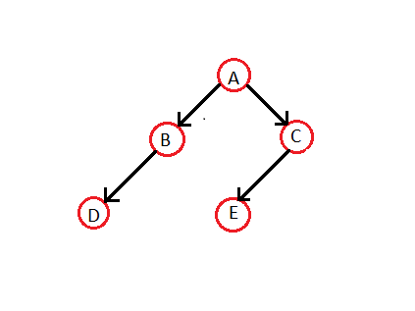
TBT – Non-Recursive Traversal
Let's make the Threaded Binary tree out of a normal binary tree:
The in-order traversal for the given tree is — D B A E C.
So, the respective Threaded Binary tree will be --

Slide 34
TBT – Non-Recursive Traversal
Algorithm
Step-1: For the current node check whether it has a left child which is not there in the visited list. If it has then go to step-2 or else step-3.
Step-2: Put that left child in the list of visited nodes and make it your current node in consideration. Go to step-6
Step-3: Print the node and If the node has a right child then go to step 4 else go to step 5
Step-4: Make the right child as the current node. Go to step 6.
Step-5: If there is a thread node then make it the current node.
Step-6: If all nodes have been printed then END else go to step 1.

Slide 35
TBT – Non-Recursive Traversal
Step No. | Explanation | Stack | O/P
Step - 1 | 'A' has a left child i.e. B, which has not been visited. So, we put B in our "list of visited nodes" and B becomes our current node in consideration. | B
Step – 2 | 'B' also has a left child, 'D', which is not there in our list of visited nodes. So, we put 'D' in that list and make it our current node in consideration. | B D
Step – 3 | ‘D' has no left child, so we print 'D'. Then we check for its right child. 'D' has no right child and thus we check for its thread-link. It has a thread going till node 'B'. So, we make 'B' as our current node in consideration. | B D | D
Step – 4 | 'B' certainly has a left child but its already in our list of visited nodes. So, we print 'B'. Then we check for its right child but it doesn't exist. So, we make its threaded node (i.e. 'A') as our current node in consideration | B D | D B
Step – 5 | A' has a left child, 'B', but it is already there in the list of visited nodes. So, we print 'A'. Then we check for its right child. 'A' has a right child, 'C' and it's not there in our list of visited nodes. So, we add it to that list and we make it our current node in consideration. | B D C | D B A
Step – 6 | 'C' has 'E' as the left child and it's not there in our list of visited nodes even. So, we add it to that list and make it our current node in consideration. | B D C E | D B A
Step – 7 |  | And Finally… | D B A E C

Slide 36
Thank You

Slide 37
TBT – Non-Recursive Traversal – In-order
Algorithm for Non-Recursive Traversal of TBT :-
Start at leftmost node and print it.
Follow thread to right and print it.
Follow link to right go to leftmost node and print it.
Follow thread to right and print it.
(repeat)

Slide 38
TBT – Non-Recursive Traversal – In-order
// Utility function to find leftmost node in a tree rooted with n
struct Node* leftMost(struct Node* n)
{
if (n == NULL)
return NULL;
while (n->left != NULL)
n = n->left;
return n;
}
// C code to do inorder traversal in a threaded binary tree
void inOrder(struct Node* root)
{
struct Node* cur = leftMost(root);
while (cur != NULL) {
printf("%d ", cur->data);
// If this node is a thread node, then go to inorder successor
if (cur->rightThread)
cur = cur->right;
else // Else go to the leftmost child in right subtree
cur = leftmost(cur->right);
}
}

Slide 39
TBT – Non-Recursive Traversal – Pre-order
Algorithm for Non-Recursive Traversal of TBT :-
Take current as root and print it.
Follow link of left, Print it and continue this till leftmost node.
Follow thread to right.
Follow link of right, print it.
Repeat through step 2.

Slide 40
TBT – Non-Recursive Traversal – Pre-order
// Non-recursive Preorder Traversal of TBT
void preOrder(Node *root)
{ Node *ptr;
if(root==NULL)
{ cout<<"Tree is empty";
return;
}
ptr=root;
while(ptr!=NULL)
{ cout<<ptr->info<<" ";
if(ptr->lthread==false)
ptr=ptr->left;
else if(ptr->rthread==false)
ptr=ptr->right;
else
{ while(ptr!=NULL && ptr->rthread==true)
ptr=ptr->right; // go to successor / parent
if(ptr!=NULL)
ptr=ptr->right; // go to right child of successor / parent
}
}
}/*End of pre-order*/

Slide 41
TBT – Non-Recursive Traversal – Post-order
Algorithm for Non-Recursive Traversal of TBT :-
Start at the root.
Follow link of left to go to leftmost node and Print it.
Follow thread to right.
Follow link to right to go to leftmost node and print it.
Follow thread to left and print it.
(repeat)

